Slide 1

Basic Details of the Team and Problem Statement
Ministry/Organization Name/Student Innovation: AICTE,MIC-student innovation
PS Code: SIH1493
Problem Statement Title: Student Innovation
Team Name: Quantum coders
Team Leader Name: Khushi Chandravanshi
Institute Code (AISHE): C-36266
Institute Name: Shree Dadaji Institute of Technology and
Science Khandwa
Theme Name: Heritage & Culture

Slide 2
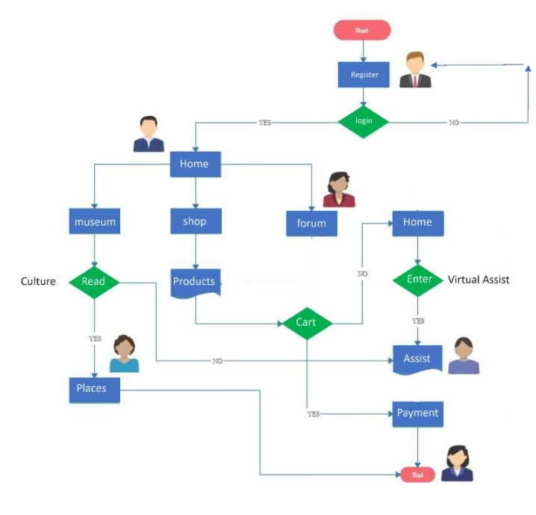



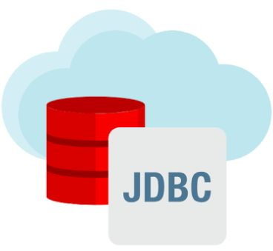













Idea/Approach Details
We’re are looking for solution by creating an Android and web-based application.
Into the both supported platforms web (block chain) & android (kotlin , flutter, dart, android) studio are used.
In our project Qrcode scanner provides list of cultural goods and unique code use to receive payments .
This application includes virtual museum to present cultural artworks like adivasi paintings, madhubani art, tanjore, miniature etc using AR/VR technology.
Our cultural food guide will showcase food of various religion & recipes a well trained ML recommender system assist user by tracking their intrest.
AI powered virtual assistance will guide user with the support of all avaliable language.
Data stored in high efficiently , fast and trustable databases like (mysql , mongodb)
An integrated marketplace developed in web 3.0 and blockchain technology.
Technology stack

Slide 3
Idea/Approach Details
Dependencies / Stoppers
Use cases
User can purchase cultural goods like furniture , hangings, textiles, paintings etc internationally by our using application.
In cultural festivals our application provides greetings virtually by ml tool it gives fame.
Our application provides GPS tracking system to the user to know about our historical places and architecture.
We are running cultural product’s ads for generating bussiness potential.
Learning indian language courses facility showcase our culture internationally by using chatbot.
User can understand about unique cultural traditions like ramlila , kumbh mela , bihu etc by using our application.
Culture and heritage related daily current news provides by our application internationally.
Classical dance, music, genesis stories , indian diverse culture etc entertain user in our application.
Mainly barrier is in our application , internationally lunching is not possible for us we need more resources (help of govt).
Selling of cultural goods needs large amount of sellers.
For using blockchain we need bitcoin.
For making bitcoin we need sliver.
Integrated system is a hurdle for gps tracking system in our application.
For making app and web both resources for users compatability need more developers.
We need experienced android develper for developing app on big level internationally.
No doubt our idea helps to showcase the rich cultural heritage and traditions of india but we need help of govt for implement it

Slide 4
Team Member Details
Team Leader Name: Khushi Chandravanshi
Branch (Btech/Mtech/PhD etc): Btech Stream (ECE, CSE etc): CSE Year (I,II,III,IV): II
Team Member 1 Name: Pravez Sheikh
Branch (Btech/Mtech/PhD etc): Btech Stream (ECE, CSE etc): DSE Year (I,II,III,IV): IV
Team Member 2 Name: Mohammed Farhan Khan
Branch (Btech/Mtech/PhD etc): Btech Stream (ECE, CSE etc): CSE Year (I,II,III,IV): IV
Team Member 3 Name: Khushboo Chawla
Branch (Btech/Mtech/PhD etc): Btech Stream (ECE, CSE etc): CSE Year (I,II,III,IV): II
Team Member 4 Name: Harsh Rathore
Branch (Btech/Mtech/PhD etc): Btech Stream (ECE, CSE etc): CSE Year (I,II,III,IV): II
Team Member 5 Name: Divyansh Soni
Branch (Btech/Mtech/PhD etc): Btech Stream (ECE, CSE etc): CSE Year (I,II,III,IV): II
Team Mentor 1 Name: Vaishali Sharma
Category - Academic Expertise: Data science Domain Experience (in years): 4 Years
Team Mentor 2 Name: Devansh toklani
Category- Academic Expertise: Python and ml Domain Experience (in years): 3 Years

